Slide 1

FORECASTING FUTURE RETURNS USING COT REPORT
Duke MQM - Finance - Team 49
Lu Lu (ll501), Meiyi Guo (mg483), Divij Yanduru (sy328), Vaibhav Chhabra(vc145)

Slide 2




OUR TEAM
Divij Yanduru
Lu Lu
Vaibhav Chhabra
Meiyi Guo

Slide 3




01
02
Approach Intruductions
Gold Future Price Forecasting Model
03
04
Crude Oil Future Price Forecasting Model
Corn Future Price Forecasting Model
Presentation Structure

Slide 4




01
Approach Intruductions

Slide 5



Rationale And Preliminary Research
COT report is the accumulation of all strategies within the market at a given time. So, it should reflect the market in itself and should give insights and information accordingly.
Research indicates futures market are inefficient and violate EMH with varying degree through:
Asset Classes
Time Horizons
Contract Sizes
And Moreover, given informational asymmetry and hedging pressure theory, COT report should have forecasting prowess

Slide 6



Proposed Approach
Given, research and intuition indicates that prediction power of COT report varies across different asset class. We want to statistically find the prediction power of COT report in select asset class.
Asset Classes
Feature Engineering
Generalized Model
Trading Signal
There can be two trading signals for a macro investor:
Follow sentiment in stable times (Trend following phase)
Trade against sentiment in extreme cases (Contrarian phase)

Slide 7
Proposed Approach
Based on the proposed approach the research tasks we have assigned are as follows:
Asset Selection (MVP): Not all assets are equally sensitive to speculative behavior. We first identify which assets are most suited for sentiment-based strategies.
Model Development (Asset-Level): Build time-series forecasting models for selected assets using historical COT data.
Feature Selection: Find features which can predict future returns across different asset classes from a baseline model. (If any)
Trading Signals: Develop useful trading signals in select asset classes/across asset class with select features (if any).

Slide 8
Asset Selection and Research
Why We Chose Commodities?
1) Deep Hedging Activity
Especially Soft Commodities such as Corn, Wheat, Soyabean
2) Strong Hedging
Pressure effects in Commodities
3) Data Coverage and High signal to Noise ratio
70-90% of coverage in commodities
Harrison & Hong (2011) found (strong) statistically significant returns prediction through COT report in commodities which supports this rationale.

Slide 9
Asset Selection and Research
Empirical studies on corn, wheat, and soybean futures reveal a rich but conflicting picture of speculator profitability
Chang (1985)
Chatrath et al. (1997)
Moran et al. (Irwin et al. 2020)
Backwardation effects—driven by an inverse hedging pressure between commercials and speculators—explain much of the passive long‑position returns in these soft commodities, making them an ideal laboratory for testing contrarian CoT signals​

Slide 10



Data Cleaning and Modeling
Instead of testing multiple contract sizes, we focused on the most liquid and promising futures contract for each commodity based on our research.
Gold
COMEX
(100 TROY OUNCES) (GC)
Crude Oil
NYMEX
WTI‑PHYSICAL
(1,000 BARRELS) (CL)
Corn
CBOT (5,000 BUSHELS)
(ZC)
All of them are considered Benchmarks/Gold standard futures for their respective commodities. Given their liquidity and data quality we have considered them.

Slide 11
Data Collection Rationale
Gold: Our dataset for Gold commences on January 9, 1995. This choice was made considering the merger of COMEX and NYMEX energy and metals exchange for both. Given improved liquidity, regulations/transparency and data availability.
Crude Oil: Crude Oil 1000 barrels NYMEX futures commences on January 3rd, 1995. Because of the above reasons. Improved liquidity, regulations/transparency and data availability
Corn : For soft commodities, Corn(CONTRACTS OF 5,000 BUSHELS) is traded on CBOT. The data for it commences on 30th March 2006 because enhanced COT reports, increased speculative position limits, e – CBOT being commenced.

Slide 12
Data Selection
Rationale and Availability
COT Reports
For the COT reports, we have used the Python library cot_report. This library is a cleaned version of the original COT reports.
Have verified its accuracy with original Json file CFTC releases (Required further Data cleaning)
Future Data
All of the futures data we have gathered is from LSEG workspace's – DataStream Library.
Dslib provides continuous series for futures that are constructed in multiple methodologies. And Many researches have used this for their COT report prediction power.

Slide 13
Continuous Futures Construction: Research and Rationale
While constructing the continuous futures we are considerate of 2 things:
1) Rollover Method
Volume, Fixed Calendar, Open Interest, Last Day of Trading/First Day of next month, Custom Trigger
2) Price Adjusting Methodology
Backward/Forward Ratio adjusted, Backward/Forward Additive adjusted, Forward chain/Perpetual Series, Panama canal adjustment (CRB method)
Research on continuous series construction to analyze COT reports reveals a wide range of methodologies.

Slide 14
Rationale and Implementation
Our suggestion based on the requirement of client needs would be to use backward ratio adjusted and both volume-based rolling and first day of next month rolling for different purposes and usage.
1
Backward Ratio adjusted
2
Volume Based Rolling
3
Expiration Based Rolling
Given the time and data availability constraints, we went ahead with CS04 from DataStream. This is a forward chain/perpetual series rolled over based on expiration date. (This is price adjusted series based on rolling yield). So, essentially, we found it to be rationale to pursue with this methodology.

Slide 15
02
Gold Future Price Forecasting Model

Slide 16
Gold Return Attribution Model (GRAM)
Proposed by the World Gold Council in 2023, the GRAM model explains gold returns using macroeconomic drivers to quantify the contribution of economic factors to monthly gold returns under different market regimes.
OLS regression, data from Feb 2007–Feb 2024, R² up to 62%
Factor Description | Calculation Method | Regression Coefficient
Developed market FX rates | Weighted average, differenced | -0.33
Developed market FX rates (lagged one month) | Weighted average, differenced, lagged | -0.23
Emerging market FX rates | Weighted average, differenced, lagged | -0.32
Gold price (lagged one month) | Differenced, lagged | -0.28
Net long positions scaled by total open interest | Differenced | 0.16
Equity/bond fund flows | Differenced | -0.39
Total assets of the Federal Reserve | Differenced, lagged | 0.11
Net_Position= Noncommercial Positions-Long (All) - Noncommercial Positions-Short (All)
Net_Change = Net_Position. diff()

Slide 17
Gold Future Price Forecasting Model – Morgan Stanley (2024Oct)
In October 2024, Morgan Stanley introduced a revised gold price regression model in response to a structural break observed in early 2022, where the inverse relationship between gold prices and real yields (10Y TIPS) significantly weakened.
Historical Relationship
Historically: ↑ Gold → ↓ Real Yields (10Y TIPS)
Post-2022: This relationship no longer holds consistently.
Morgan Stanley integrated high-frequency and demand-side indicators to capture evolving market dynamics.
Model Performance
Previous model (10Y TIPS only): R² = 0.31
Enhanced multi-factor model: R² = 0.94
Category | Variable
Interest Rate | 10Y TIPS yield
Currency | USD Index (DXY)
Inflation Expectation | US CPI Index
Institutional Demand | Central Bank Gold Purchases
ETF Flows | Net global gold ETF holdings
Risk Sentiment | Global Risk Index (geopolitical events)
Positioning | CFTC Net Speculative Positions (futures)
Net_Position=
Noncommercial Positions-Long (All) - Noncommercial Positions-Short (All)

Slide 18
Gold Future Price Forecasting Model – Morgan Stanley (2024Oct)
Below are the changes in the regression coefficients of key gold price drivers across different 5-year periods.
Factor | Unit | 2003–2024 | 2004–2009 | 2009–2014 | 2014–2019 | 2019–2024
US 10-yr TIPS only | % | -73.4 | 56.2 | -55.9 | -52 | 100.7
ETF Holdings | Moz (million oz) | 4.8 | 6.4 | -3.3 | 4 | 11.2
CB Reserves | Moz | -1.3 | 1 | -1.3 | -1.6 | 15.4
DXY | Index | -11.4 | -10 | -1.2 | -3.7 | -0.7
CPI Index | Index | 12.9 | -5.1 | 10.3 | 8.7 | 1.4
Global Risk Index | Index | 0.45 | 0.55 | 1.53 | 1.11 | -0.66
CFTC Net Positioning | Contracts ('000) | 0.56 | 0.14 | 0.39 | 0.49 | 2.56
R-Squared | — | 0.94 | 0.6 | 0.62 | 0.92 | 0.89
Notably, the predictive power of CFTC Net Positioning has significantly increased in recent years, with its regression coefficient rising from 0.14 (2004–2009) to 2.56 (2019–2024).
This indicates that speculative positioning has become a more prominent short- to medium-term driver of gold futures prices, potentially reflecting a stronger role of market sentiment and momentum.

Slide 19



1. Role of CoT Data in Fundamental Models
one of many variables used in macro-based gold price models
not the dominant driver in frameworks centered on fundamental indicators such as real interest rates, inflation, and institutional demand.
2. Reframing CoT as a Trading Signal
CoT data reflects market sentiment and positioning
This approach shifts the focus from structural fundamentals to behavioral and tactical signals.
3. A Behavioral Finance Perspective
This repositioning of CoT data aligns with the logic of behavioral finance emphasizing speculative behavior, trading dynamics, and positioning trends.
It provides a distinct and valuable lens through which to study gold price movements, particularly under volatile or non-fundamentally driven regimes.

Slide 20
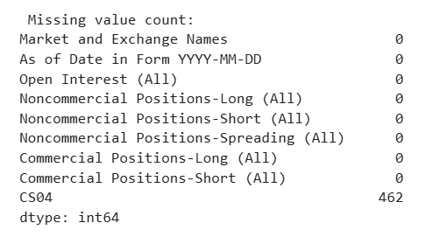
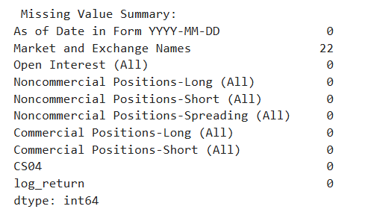
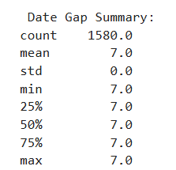
Data Source and Preprocessing
Dataset | Source | Frequency
CoT Report (Legacy) | CFTC Commitment of Traders | Weekly (Tuesday)
Price Data (CS04) | Market-based gold price return series | Weekly (Tuesday)
Time Span: 1995-01-10 to 2025-04-15
After we merged the data, CS04 had missing values on certain dates. To prevent forward-looking bias, we filled missing CS04 values using the previous available value
Before
After👍

Slide 21
Feature Engineering: Constructing CoT-Based Predictors
1.Base Variables (From Raw CoT Data)
3. Interaction and Regime-Based Features
Open Interest (All)
Noncommercial Positions - Long
Noncommercial Positions - Short
Noncommercial Positions - Spread
Commercial Positions - Long/Short
CS04
Feature Name | Interpretation
NetRatio_OI | Position ratio weighted by market size
NetChange_NetLag1 | Interaction between recent change and lagged position
LongShort_Interaction | Balance between long and short ratios
Zscore_Net | Net positioning relative to 52-week norm
Extreme_Positive / Negative | High/low sentiment regimes (Z-score > 1.5 or < -1.5)
2. Constructed Positioning & Ratio Features
Category | Variables
Net Positioning | Net_Position, Net_Change, Net_Change_Ratio, Net_Position_Lag1
Ratios | Long_Ratio, Short_Ratio, Net_Ratio, Net_Ratio_Lag1
Commercial Behavior | Comm_Net_Position, Comm_Net_Change, Comm_Zscore
Spread Activity | Spread_Ratio, Spread_Change, Spread_Std_4w
Open Interest Dynamics | OI_Change, OI_Change_Pct, OI_Std_4w

Slide 22
Feature Engineering: Constructing CoT-Based Predictors
We create our features inspiring by prior researches on how net positioning and open interest dynamics affect futures pricing behavior.
Feature Name | Formula | Rationale (Literature Support)
Net_Position | Noncommercial Long - Noncommercial Short | Measures market sentiment; MM net positions predict returns (Ho & Lauwers, 2019)
Long_Ratio | Noncommercial Long / Open Interest | Reflects long position intensity (Laubsch et al., 2024)
Short_Ratio | Noncommercial Short / Open Interest | Reflects short position pressure (Laubsch et al., 2024)
Net_Ratio | Net_Position / Open Interest | Removes market size bias; enhances comparability
Net_Change | Net_Position(t) - Net_Position(t-1) | Net position change can predict short-term price direction
Net_Change_Ratio | Net_Change / Open Interest | Standardized change magnitude
Net_Position_Lag1 | Net_Position(t-1) | Lagged net position for momentum and lag analysis
Net_Ratio_Lag1 | Net_Ratio(t-1) | Lagged net ratio for momentum modeling
NetRatio_OI | Net_Ratio × Open Interest | measures market concentration
NetChange_NetLag1 | Net_Change × Net_Position_Lag1 | captures reversals and accelerations
LongShort_Interaction | Long_Ratio × Short_Ratio | Interaction of long and short ratios; nonlinear conflict signal
Zscore_Net | (Net_Position - mean(Net_Position_52w)) / std(Net_Position_52w) | Z-score of net position over 52-week mean/std (Kaabar, 2018)
Extreme_Positive | Zscore_Net > 1.5 | Flag if Z-score > 1.5; indicates extreme optimism
Extreme_Negative | Zscore_Net < -1.5 | Flag if Z-score < -1.5; indicates extreme pessimism
OI_Lag1 | Open Interest(t-1) | Lagged open interest
OI_Change | Open Interest(t) - OI_Lag1 | Current OI - previous OI
OI_Change_Pct | OI_Change / OI_Lag1 | Change rate of open interest; forecasts return (Hong & Yogo, 2011)

Slide 23
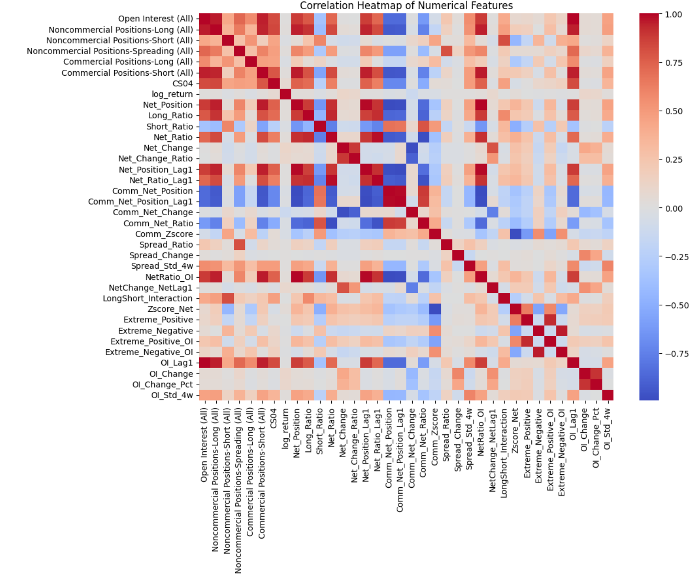
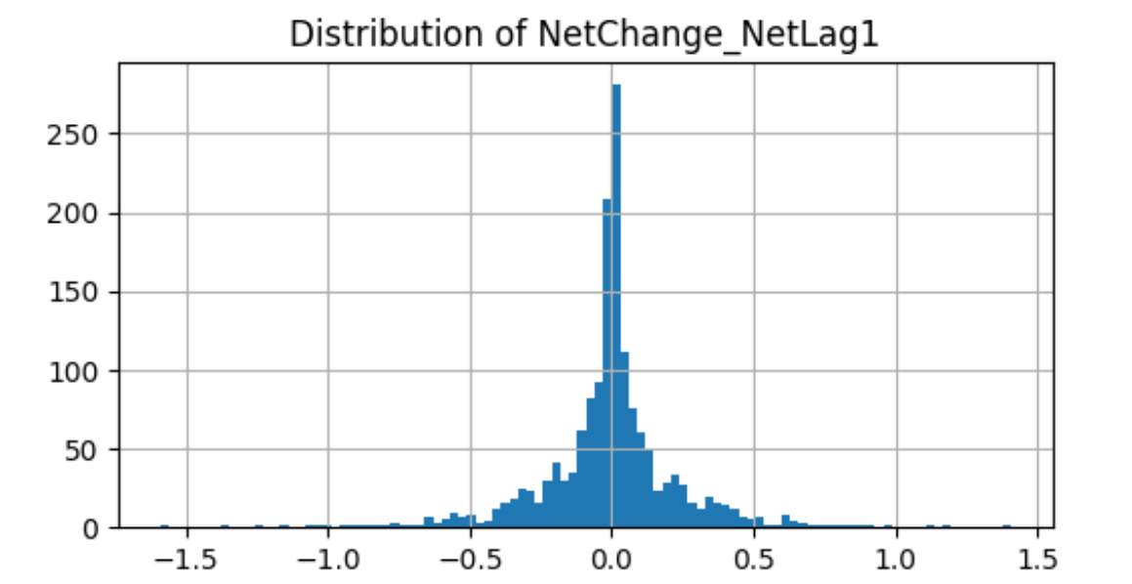
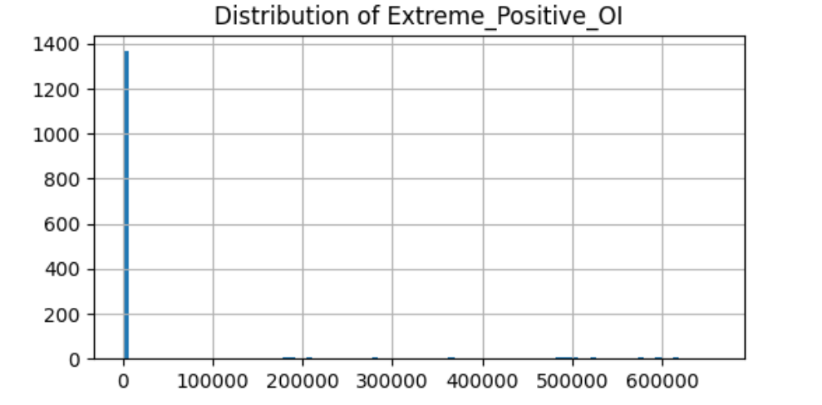
Feature Engineering: Feature Selection
We create our features inspiring by prior researches on how net positioning and open interest dynamics affect futures pricing behavior.
Step | Criterion | Rationale
1 | Low Variance Removal (variance < 1e-5) | Eliminates features with no signal across samples
2 | High Correlation Removal (correlation > 0.95) | Reduces multicollinearity and model instability
3 | Skewed Feature Removal(extreme range or outliers) | Removes features dominated by rare or volatile values
Initial numeric features: 38 Features
dropped:
Low variance: 0 features
Highly correlated: 15 features
Skewed/extreme distributions: 5 features
Final feature set (X_final) contains: 18 features

Slide 24
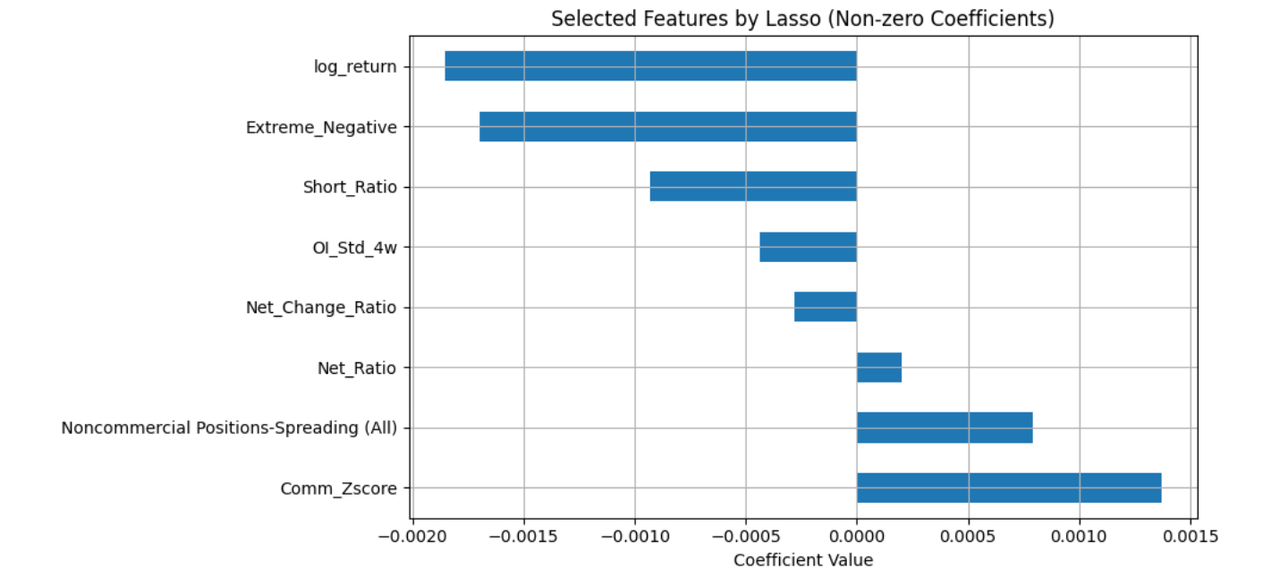
Feature Engineering: Feature Selection via Lasso Regression
Applied LassoCV to identify features with strongest predictive signal.
Conducted 50-fold cross-validation to ensure stability and avoid overfitting.
Result: Lasso selected 8 non-zero coefficient features, including both raw and engineered variables.
Note: Lasso features selected on full sample for reference only; not used directly in rolling forecasts to avoid information leakage.

Slide 25
Feature Engineering: Feature Selection via Lasso Regression
Feature Name | Explanation | Market Implication
Comm_Zscore | Z-score of commercial net positions (vs 52-week average) | Represents supply-demand expectations from institutional players
Noncommercial Positions-Spreading (All) | Spreading positions by speculators (usually long-short hedges) | Suggests increased volatility or rise in market activity
Net_Ratio | Net long positions / total open interest | Directional indicator for trend-following behavior
Net_Change_Ratio | Weekly change in net positions / total open interest | Behavioral signal of positioning adjustment
OI_Std_4w | Standard deviation of open interest over the past 4 weeks | Signals changing liquidity or pre-volatility rise
Short_Ratio | Short speculative positions / total open interest | Market sentiment signal – speculative pessimism
Extreme_Negative | Dummy variable: Net Z-score < –1.5 (extreme pessimism) | Contrarian signal – potential rebound after panic
log_return | Log return of gold in the previous week | Technical analysis or behavioral trading persistence

Slide 26
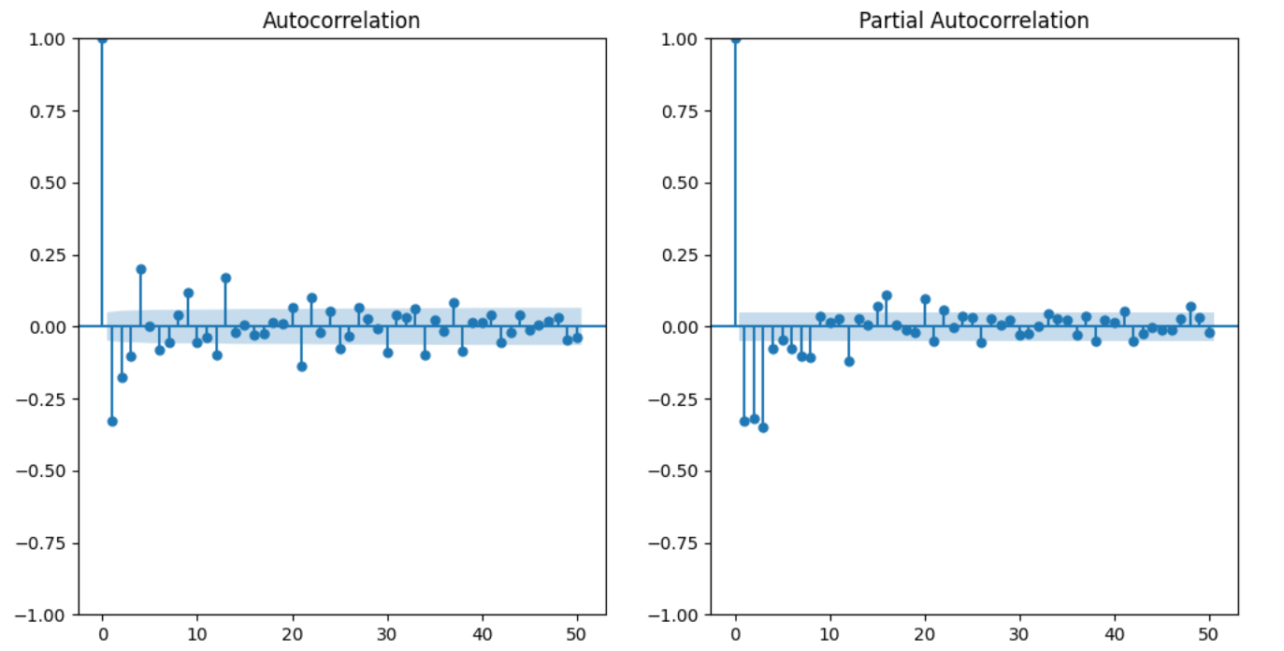
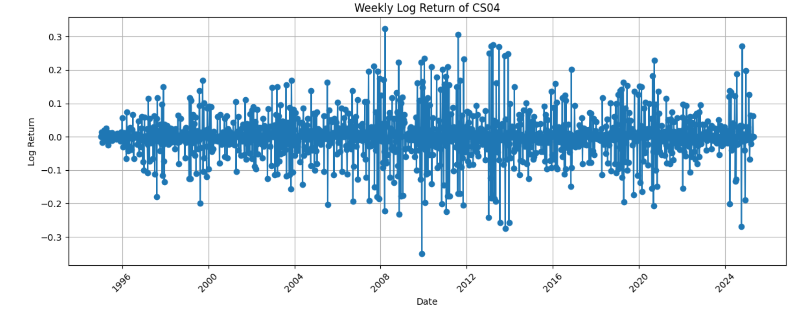
EDA - model choice
Residual correlation: Linear model residuals remain correlated with features like Extreme_Negative and Short_Ratio, suggesting missed nonlinear effects.
Volatility clustering: ACF/PACF plots reveal time-dependent structure in returns → GARCH is appropriate.
Heteroscedasticity: Breusch-Pagan test confirms non-constant error variance → ARIMA + GARCH preferred.

Slide 27
Model Compare
Rolling Forecast Framework:
Training window: 52 weeks(linear &XGBoost); 80 weeks(Arima)
Forecast horizon: 1 week ahead
Rolling step: 1 week (expanding or fixed window)
Target Variable:Weekly gold return = log(CS04_t+1) – log(CS04_t)
***We manually experimented with non-Lasso feature sets as well, but the Lasso-selected features consistently delivered the best predictive performance.
model | feature | OOS R^2 | OOS MSE
linear regression | all features | 0.2154 | 0.0095
linear regression | selected features | 0.0831 | 0.0057
XGBoost | all features | -0.5082 | 0.0064
XGBoost | selected features | -0.4375 | 0.0061
Arima(0,0,0) | all features | -0.5169 | 0.0065
Arima(0,0,0) | selected features | -0.1649 | 0.0050
Arima(1,0,0) | all features | -0.4377 | 0.0061
Arima(1,0,0) | selected features | -0.0733 | 0.0046
Arima(1,0,1) | all features | -0.4574 | 0.0062
Arima(1,0,1) | selected features | -0.1012 | 0.0047
Arima(1,1,1) | selected features | -0.5495 | 0.0069
Arima(1,0,0)+Garch | selected features | -0.0733 | 0.0046
Based on the goal of our research—forecasting short-term gold futures returns using CoT data—we prioritize prediction accuracy (MSE) over interpretability (R²).

Slide 28
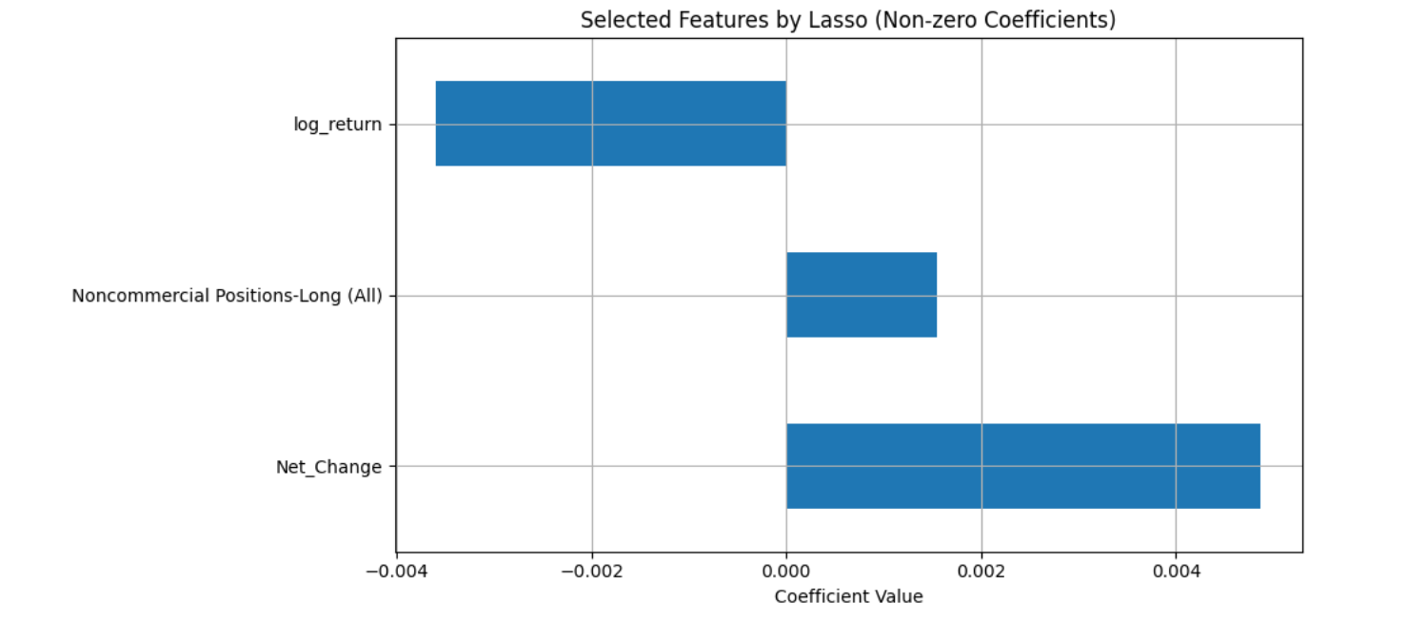
Extended Analysis: Post-2022 Regime Shift in Gold Price Drivers
1. Motivation
Recent industry and academic reports have highlighted a structural change in gold pricing mechanisms since early 2022.
2. Our Exploratory Study (2022.04–2025.04)
Focus: Test if CoT-based models remain predictive in the post-2022 regime
Method: Re-trained models on recent 3-year window
Best model: Linear Regression with Lasso-selected features, rolling window = 26 weeks.
Results: average R²= 0.103, average MSE = 0.0019
Indicates modest explanatory power, but high prediction stability, consistent with recent literature findings.
Top predictive variables align with those emphasized in 2023–2024 research reports:
Log_return & Net change

Slide 29
Extended Analysis: COMEX vs. CS04
In our earlier stages of research, we built forecasting models using gold futures prices from Yahoo Finance (COMEX, GC=F).
Later, to maintain consistency with the CFTC CoT report’s ratio-based position measures, we replaced COMEX with CS04, a structured spot proxy series.
As you can see, our former model outcome is much more better than now:
Best Model | Data Source | R square | MSE
ARIMAX(1,0,1)+Garch | COMEX | 0.3851 | 0.0001
ARIMAX(1,0,1)+Garch | CS04 | -0.0733 | 0.0046
Our guess for the difference:
CS04 is a smoothed and synthetic spot-price proxy, constructed for long-term macroeconomic analysis. As a reult, it lacks the short-term volatility and trading sentiment that are critical for behavior-based predictive models.
In contrast, COMEX futures prices reflect real market transactions and are highly sensitive to investor expectations and speculative pressure.
Since our analysis is based on the COT report, it is essentially grounded in behavioral finance, where market sentiment forms the basis of our strategy. Due to the lack of high-frequency fluctuations and sentiment responsiveness in the CS04 data, the model’s performance may deteriorate significantly.

Slide 30
03
Crude Oil Future Price Forecasting Model

Slide 31
Why Commitment of Traders (CoT) Matters
Speculative flows heavily influence short-term crude oil prices, especially during demand shocks and geopolitical disruptions. (Kilian & Murphy, 2014)
Positioning extremes in oil futures markets predict future mean-reversions, offering contrarian trading opportunities. (Alquist & Gervais, 2013)
Post-2000 Financialization: Increased participation by non-commercial traders (hedge funds, CTAs) has made crude oil prices more sensitive to shifts in speculative positioning. (Irwin & Sanders, 2012)
During periods of supply uncertainty (e.g., SPR releases, OPEC+ cuts), "who holds the barrels" — speculators vs. commercials — matters as much as inventory data or production numbers.

Slide 32
Data Source and Preprocessing
Dataset | Source | Frequency
CoT Report (Legacy) | CFTC Commitment of Traders | Weekly (Tuesday)
Price Data (CS04) | Market-based gold price return series | Weekly (Tuesday)
Time Span: 1995-01-10 to 2025-04-15
After we merged the data, CS04 had missing values on certain dates. To prevent forward-looking bias, we filled missing CS04 values using the previous available value
Before
After

Slide 33
Feature Engineering: Constructing CoT-Based Predictors
1.Base Variables (From Raw CoT Data)
3. Interaction and Regime-Based Features
Open Interest (All)
Noncommercial Positions - Long
Noncommercial Positions - Short
Noncommercial Positions - Spread
Commercial Positions - Long/Short
CS04
Feature Name | Interpretation
NetRatio_OI | Position ratio weighted by market size
NetChange_NetLag1 | Interaction between recent change and lagged position
LongShort_Interaction | Balance between long and short ratios
Zscore_Net | Net positioning relative to 52-week norm
Extreme_Positive / Negative | High/low sentiment regimes (Z-score > 1.5 or < -1.5)
2. Constructed Positioning & Ratio Features
Category | Variables
Net Positioning | Net_Position, Net_Change, Net_Change_Ratio, Net_Position_Lag1
Ratios | Long_Ratio, Short_Ratio, Net_Ratio, Net_Ratio_Lag1
Commercial Behavior | Comm_Net_Position, Comm_Net_Change, Comm_Zscore
Spread Activity | Spread_Ratio, Spread_Change, Spread_Std_4w
Open Interest Dynamics | OI_Change, OI_Change_Pct, OI_Std_4w

Slide 34
Feature Engineering: Constructing CoT-Based Predictors
We create our features inspiring by prior researches on how net positioning and open interest dynamics affect futures pricing behavior.
Feature Name | Formula | Rationale & Literature Support
Net_Position | Non-Commercial Longs − Shorts | Captures overall speculative bias (Kilian & Murphy, 2014)
Long_Ratio | Longs / Open Interest | Gauges bullish conviction (Ready, 2018)
Short_Ratio | Shorts / Open Interest | Gauges bearish conviction (Basu & Miffre, 2013)
Net_Ratio | (Longs − Shorts) / Open Interest | Scaled net bias; controls for market size changes
Net_Change | Net_Position.diff() | Captures weekly speculative flow changes (Büyüksahin & Harris, 2011)
Net_Change_Ratio | Net_Change / Open Interest | Flow change normalized for liquidity (Ready, 2018)
Net_Position_Lag1 | Net_Position.shift(1) | Prior week's speculative stance
Net_Ratio_Lag1 | Net_Ratio.shift(1) | Prior week's scaled stance; for momentum testing
NetRatio_OI | Net_Ratio * OI Change % | Interaction effect; large flows with OI expansion
NetChange_NetLag1 | Net_Change / Net_Position_Lag1 | Flow intensity relative to existing net position
LongShort_Interaction | Long_Ratio * Short_Ratio | Measures polarization; crowding risk
Zscore_Net | (Net_Position - 52wk mean) / 52wk std dev | Standardized speculative deviation (Basu & Miffre, 2013)
Extreme_Positive | 1 if Zscore_Net > 1.5 else 0 | Flag speculative excess longs
Extreme_Negative | 1 if Zscore_Net < −1.5 else 0 | Flag speculative excess shorts
OI_Lag1 | OI.shift(1) | Last week's market depth measure
OI_Change | OI.diff() | Absolute weekly liquidity movement
OI_Change_Pct | OI_Change / OI_Lag1 | % Liquidity shock indicator (CFTC OCE 2014)

Slide 35
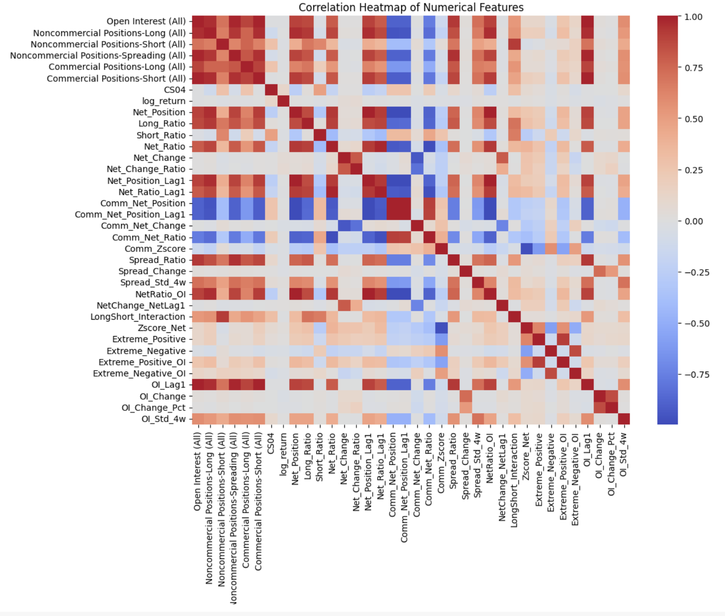
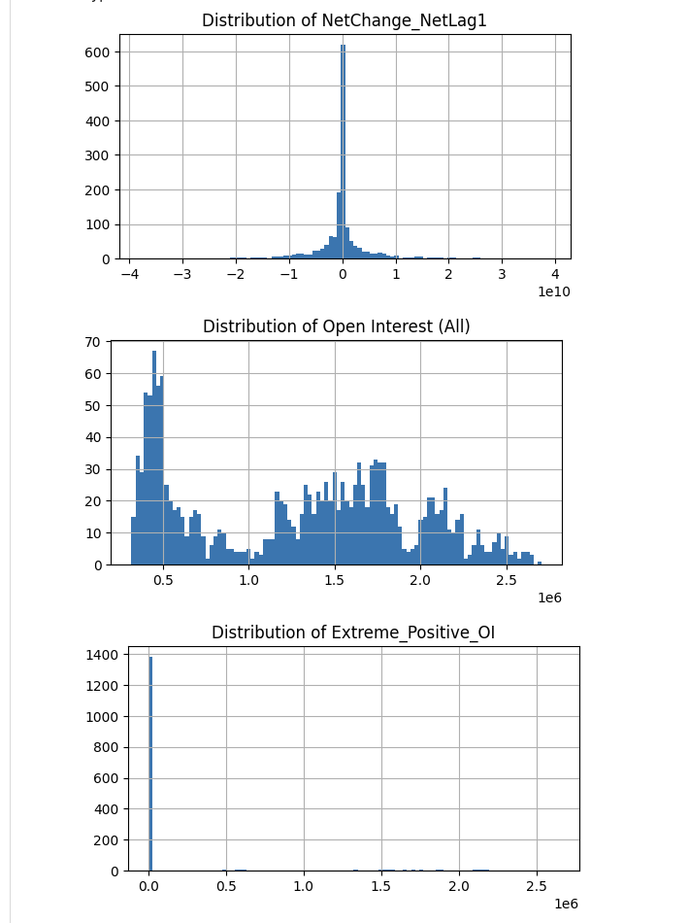
Feature Engineering: Feature Selection
We create our features inspiring by prior researches on how net positioning and open interest dynamics affect futures pricing behavior.
Step | Criterion | Rationale
1 | Low Variance Removal (variance < 1e-5) | Eliminates features with no signal across samples
2 | High Correlation Removal (correlation > 0.95) | Reduces multicollinearity and model instability
3 | Skewed Feature Removal(extreme range or outliers) | Removes features dominated by rare or volatile values
Initial numeric features: 38 Features
Dropped the following:
Low variance: 0 features
Highly correlated: 15 features
Skewed/extreme distributions: 3 features
Final feature set (X_final) contains: 20 features

Slide 36
Hedging Pressure and Speculative Flows as Predictors of Crude Oil Returns
Factor | Calculation (weekly) | Regression Result | Key Source
Net Long Position scaled by Total Open Interest | (Non-commercial Longs – Shorts) ÷ Open Interest | Positive coefficient (β ≈ 0.42) in OLS regression predicting next-month excess returns. Highly significant (t ≈ 3.1) | Basu & Miffre (2013), Journal of Banking & Finance
Weekly Change in Net Long Positions (Flow) | 1st difference of Net Position | Positive relationship (β ≈ 0.18 for WTI) to next week's price change; significant at 1% level | Büyüksahin & Harris (2011), Energy Economics
Commercial Hedger Net Z-Score | 52-week z-score of Commercial Net Position | Negative coefficient (β ≈ -0.27) — when commercials heavily short, returns decrease following week | Ready (2018), Journal of Financial and Quantitative Analysis
Open Interest Change (%) | (OI this week – OI last week) ÷ OI last week | Positive contribution to returns (every +1σ in OI adds ≈ 0.12% return next week) | CFTC Office of Chief Economist (2014)
Regression coefficients here back the idea that these positioning metrics have predictive power.
These sources focus on weekly or monthly returns, similar to our 1-week forecasting setup.

Slide 37
Speculative Demand & Inventory Impact (Kilian & Murphy 2014)
Shock Type | Variance Share (Short Run) | Variance Share (Long Run)
Speculative Demand Shock (via CoT-style measures) | ~29% of inventory volatility | ~9% of price volatility
Flow Supply Shock | ~26% | ~3%
Flow Demand Shock | ~2% | ~87%
Flow supply/demand shocks alone can't explain observed inventory dynamics. Speculative positioning explains material variation in inventories and prices.
Implication: Speculative positioning has causal power, validating our use of CoT non-commercial nets as predictors.
We use the Speculative Net Positions feature to attempt to capture these speculative shocks quantitatively.

Slide 38
Risk Premium & Hedging Pressure (Basu & Miffre 2013)
Commercial hedging pressure yields an average 7.6% annualized risk premium across energy futures.
When commercials hedge aggressively (net short increases), expected futures returns increase
Methodology:
Constructed long-short portfolios based on CFTC CoT hedging pressure (Commercial Net Positions).
Long portfolios = commodities where commercial shorting is highest (i.e., producers hedging heavily).
Found statistically significant positive returns, implying that when hedgers are short, expected returns rise (risk premium).
Crude Oil contributed a large share of this documented premium.
The Commercial Net Position Z-Score we engineered captures this hedging pressure effect.
Contrarian signals from Commercials (they hedge more when future prices are expected to fall) are backed by this study.

Slide 39
Speculative Net Flows & Short-Term Prediction (Büyüksahin & Harris 2011)
Focused on weekly WTI and Brent CoT data.
Granger causality tests showed that:
Changes in Managed Money Net Longs Granger-cause price changes at 1–3 day lags.
Price changes do not Granger-cause positioning changes.
Stronger Granger causality during boom/bust phases (e.g., 2007–2008 commodity rally and crash).
Highlighted Δ Spec Net as a leading signal rather than a coincident or lagging one.
These results support using flows (Δ Net Position) over levels (just Net Position) for better short-term forecasts.
Shows that in volatile periods (like post-2022 energy shocks), CoT flows matter even more.

Slide 40
Open Interest & Volatility (CFTC OCE Study, 2014)
Open interest changes forecast price volatility and trend continuation.
↑ OI with ↑ Price: trend confirmation
↑ OI with ↓ Price: panic selling / short capitulation
Volatility clustering linked to bursts in open interest standard deviation.
Direct link to our model:
OI Change, OI % Change, and OI Std (4-week) were engineered to capture these dynamics.
The GARCH volatility model is layered on top to predict conditional variance.

Slide 41
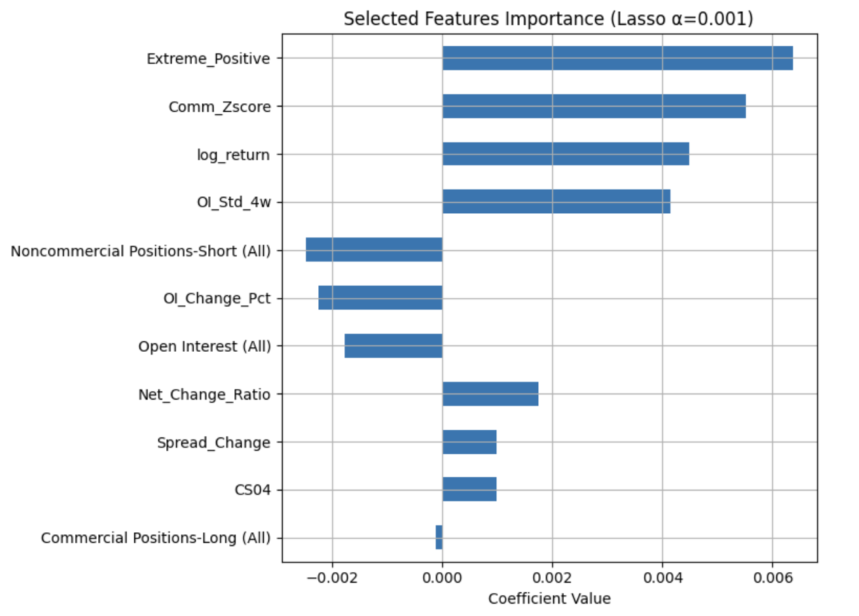
Feature Engineering: Feature Selection via Lasso Regression
Applied Lasso to identify features with the strongest predictive signal.
Fixed penalty α = 0.001 (small value to retain more features), Maximum iterations = 50,000 for convergence.
Result: Lasso selected 11 non-zero coefficient features, including both raw and engineered variables.
Note: Lasso features selected on full sample for reference only; not used directly in rolling forecasts to avoid information leakage.

Slide 42
Model Compare
Rolling Forecast Framework:
Training window: 52 weeks(linear &XGBoost); 80 weeks(Arima)
Forecast horizon: 1 week ahead
Rolling step: 1 week (expanding or fixed window)
Target Variable:Weekly gold return = log(CS04_t+1) – log(CS04_t)
model | feature | OOS R^2 | OOS MSE
linear regression | all features | 0.2811 | 0.0613
linear regression | selected features | 0.1562 | 0.0401
XGBoost | all features | -0.4779 | 0.0402
XGBoost | selected features | -0.4379 | 0.0391
Arima(0,0,0) | all features | -0.5392 | 0.0412
Arima(0,0,0) | selected features | -0.2304 | 0.0329
Arima(1,0,0) | all features | -0.4699 | 0.0394
Arima(1,0,0) | selected features | -0.1563 | 0.0309
Arima(1,0,1) | all features | -0.5138 | 0.0405
Arima(1,0,1) | selected features | -0.1896 | 0.0318
Arima(1,1,1) | selected features | -0.4080 | 0.0378
Arima(1,0,0)+Garch | selected features | -0.4766 | 0.0387
Based on the goal of our research—forecasting short-term crude oil futures returns using CoT data—we prioritize prediction accuracy (MSE) over interpretability (R²).

Slide 43
Post-2022 Regime Shift in Crude Oil Market Dynamics
Major macro events around 2022 structurally changed crude oil markets:
U.S. Strategic Petroleum Reserve (SPR) releases (~180M barrels announced in 2022)
OPEC+ production cuts
Russia-Ukraine war impacts on global crude supply chains
Rising U.S. interest rates affecting speculative behavior in commodities
Historically, speculative positioning (CoT Net Longs) showed stable relationships with future returns.
After 2022, positioning signals became more regime-dependent:
SPR releases depressed prices despite net-long speculator buildups.
OPEC+ cuts reignited supply risk premiums, making flows more predictive again.
Increased volatility clustering observed post-2022 — requiring adaptive volatility models (e.g., GARCH).

Slide 44
04
Corn Future Price Forecasting Model

Slide 45
Trader Composition in Agricultural Futures Markets
Source:
Robe and Roberts, "Who Holds Positions in Agricultural Futures Markets" (CFTC).
Trader Categories:
Commercial Hedgers — Producers, processors, merchandisers (risk management focus).
Swap Dealers — Financial intermediaries providing OTC exposure (structural hedging).
Managed Money — Hedge funds, CTAs (speculative, trend-driven positions).
Other Reportables — Institutions not fitting standard categories.
Non-Reportables — Retail and small traders (non-strategic flows).
Key Findings:
Financial participants (Swap Dealers, Managed Money) now major players alongside Commercials.
Corn futures have partially financialized — motives are no longer purely tied to supply-demand fundamentals.
Trader category matters for liquidity, price discovery, and volatility dynamics.

Slide 46
Modeling Insights: Trader Behavior and Corn Futures
Key Insights:
Commercials: Net buying → Predicts positive future returns (contrarian, informed trading).
Managed Money: Net buying → Signals momentum, but extreme positions → Predict reversals (crowded trades unwind).
Other Reportables: Mixed behavior; lower predictive value.
Application to Modeling:
Feature Construction:
Net position changes (% or absolute).
Z-scores of net positions (detect extremes).
Commercial vs. Speculator divergence metrics.
Market Condition Sensitivity:
Predictive power weakens during market stress (e.g., crisis periods).
Source: "The Predictive Effect of Heterogeneous Investor Behavior on Commodity Futures Prices", Humanities and Social Sciences Communications, 2025.

Slide 47
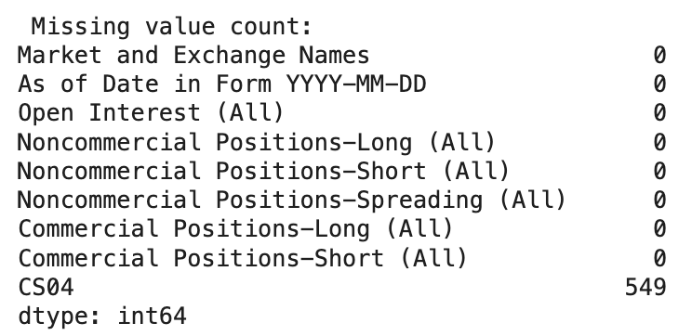
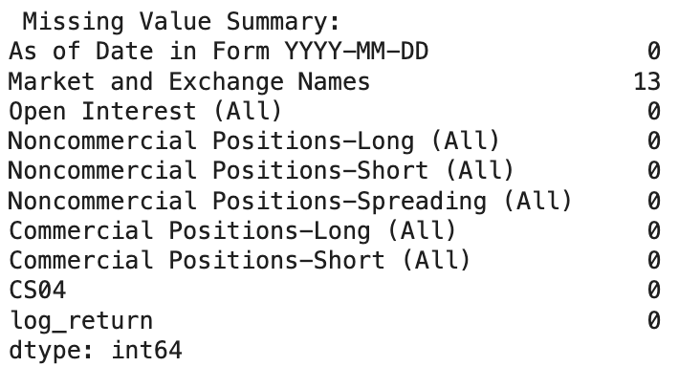
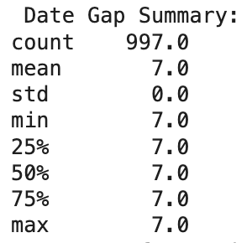
Data Source and Preprocessing
Dataset | Source | Frequency
CoT Report (Legacy) | CFTC Commitment of Traders | Weekly (Tuesday)
Price Data (CS04) | Market-based Corn price return series | Weekly (Tuesday)
Time Span: 2006-03-14 to 2025-04-15
After we merged the data, CS04 had missing values on certain dates. To prevent forward-looking bias, we filled the missing CS04 values using the previous available value
Before
After

Slide 48
Feature Engineering: Constructing CoT-Based Predictors
1.Base Variables (From Raw CoT Data)
3. Interaction and Regime-Based Features
Open Interest (All)
Noncommercial Positions - Long
Noncommercial Positions - Short
Noncommercial Positions - Spread
Commercial Positions - Long/Short
CS04
Feature Name | Interpretation
NetRatio_OI | Position ratio weighted by market size
NetChange_NetLag1 | Interaction between recent change and lagged position
LongShort_Interaction | Balance between long and short ratios
Zscore_Net | Net positioning relative to 52-week norm
Extreme_Positive / Negative | High/low sentiment regimes (Z-score > 1.5 or < -1.5)
2. Constructed Positioning & Ratio Features
Category | Variables
Net Positioning | Net_Position, Net_Change, Net_Change_Ratio, Net_Position_Lag1
Ratios | Long_Ratio, Short_Ratio, Net_Ratio, Net_Ratio_Lag1
Commercial Behavior | Comm_Net_Position, Comm_Net_Change, Comm_Zscore
Spread Activity | Spread_Ratio, Spread_Change, Spread_Std_4w
Open Interest Dynamics | OI_Change, OI_Change_Pct, OI_Std_4w

Slide 49
Feature Engineering: Constructing CoT-Based Predictors
We create our features inspiring by prior researches on how net positioning and open interest dynamics affect futures pricing behavior.
Feature Name | Formula | Rationale (Literature Support)
Net_Position | Noncommercial Long - Noncommercial Short | Measures market sentiment; MM net positions predict returns (Ho & Lauwers, 2019)
Long_Ratio | Noncommercial Long / Open Interest | Reflects long position intensity (Laubsch et al., 2024)
Short_Ratio | Noncommercial Short / Open Interest | Reflects short position pressure (Laubsch et al., 2024)
Net_Ratio | Net_Position / Open Interest | Removes market size bias; enhances comparability
Net_Change | Net_Position(t) - Net_Position(t-1) | Net position change can predict short-term price direction
Net_Change_Ratio | Net_Change / Open Interest | Standardized change magnitude
Net_Position_Lag1 | Net_Position(t-1) | Lagged net position for momentum and lag analysis
Net_Ratio_Lag1 | Net_Ratio(t-1) | Lagged net ratio for momentum modeling
NetRatio_OI | Net_Ratio × Open Interest | measures market concentration
NetChange_NetLag1 | Net_Change × Net_Position_Lag1 | captures reversals and accelerations
LongShort_Interaction | Long_Ratio × Short_Ratio | Interaction of long and short ratios; nonlinear conflict signal
Zscore_Net | (Net_Position - mean(Net_Position_52w)) / std(Net_Position_52w) | Z-score of net position over 52-week mean/std (Kaabar, 2018)
Extreme_Positive | Zscore_Net > 1.5 | Flag if Z-score > 1.5; indicates extreme optimism
Extreme_Negative | Zscore_Net < -1.5 | Flag if Z-score < -1.5; indicates extreme pessimism
OI_Lag1 | Open Interest(t-1) | Lagged open interest
OI_Change | Open Interest(t) - OI_Lag1 | Current OI - previous OI
OI_Change_Pct | OI_Change / OI_Lag1 | Change rate of open interest; forecasts return (Hong & Yogo, 2011)

Slide 50
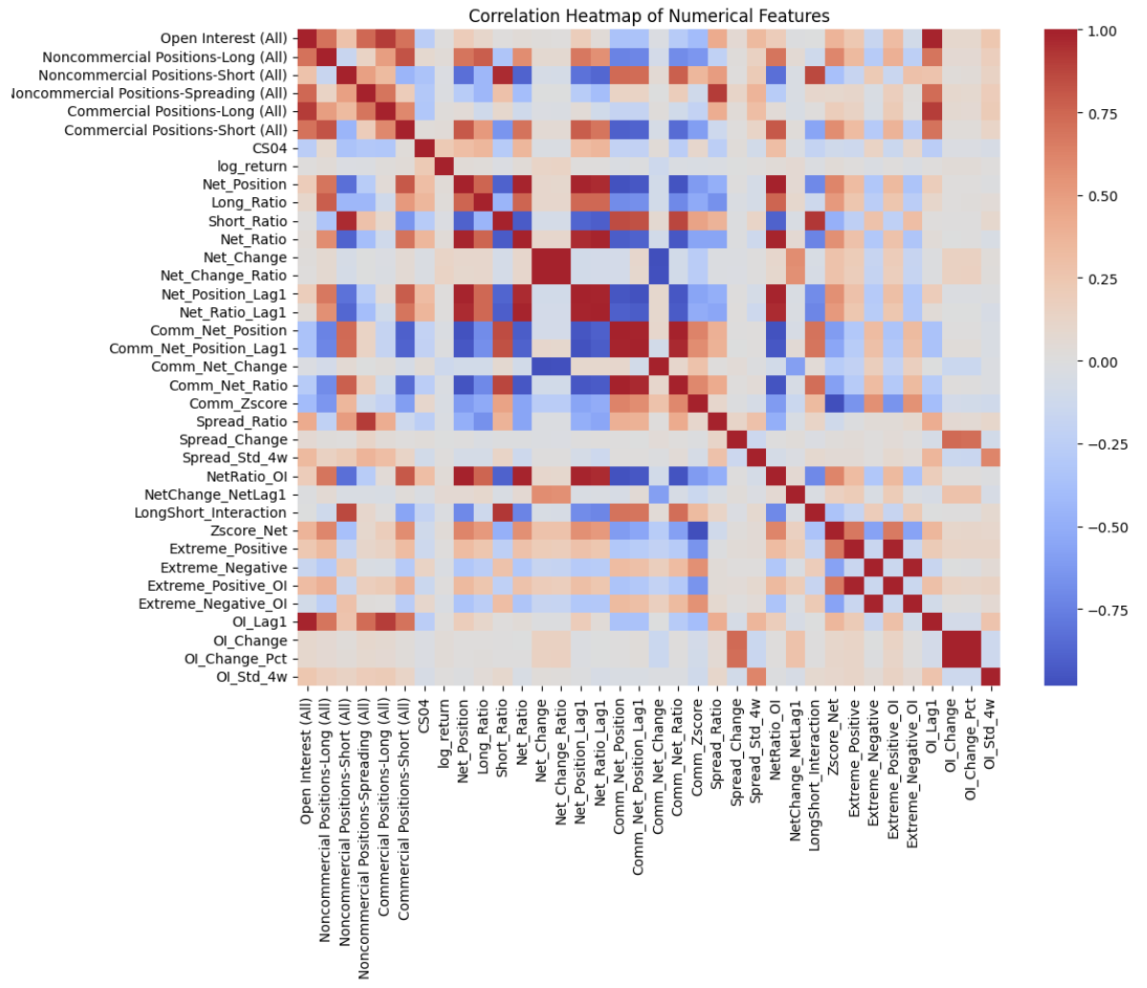
Feature Engineering: Feature Selection
We create our features inspired by prior research on how net positioning and open interest dynamics affect futures pricing behavior.
Step | Criterion | Rationale
1 | Low Variance Removal (variance < 1e-5) | Eliminates features with no signal across samples
2 | High Correlation Removal (correlation > 0.95) | Reduces multicollinearity and model instability
3 | Skewed Feature Removal(extreme range or outliers) | Removes features dominated by rare or volatile values
Dropped the following:
Low variance: 0 features
Highly correlated: 15 features
Skewed/extreme distributions: 5 features
Final feature set (X_final) contains: 15 features

Slide 51
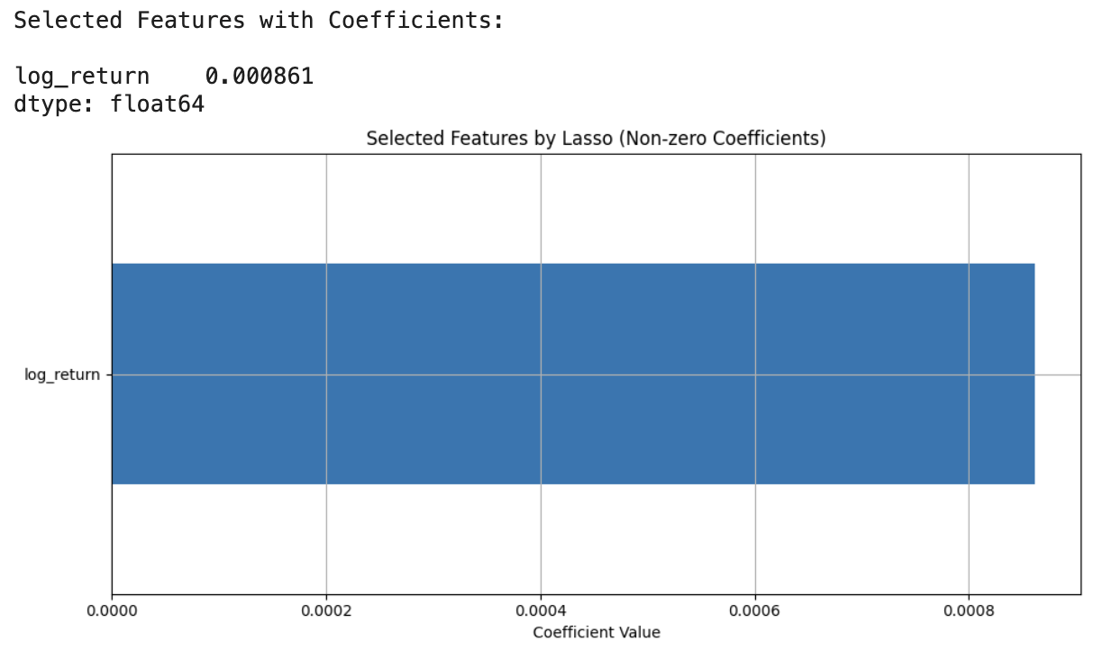
Feature Engineering: Feature Selection via Lasso Regression
Applied Lasso to identify features with the strongest predictive signal.
Fixed penalty α = 0.001 (small value to retain more features), Maximum iterations = 50,000 for convergence.
Result: Lasso selected 1 non-zero coefficient feature, including both raw and engineered variables.
Note: Lasso features selected on full sample for reference only; not used directly in rolling forecasts to avoid information leakage.
Market implication: Technical analysis or behavioral trading persistence

Slide 52
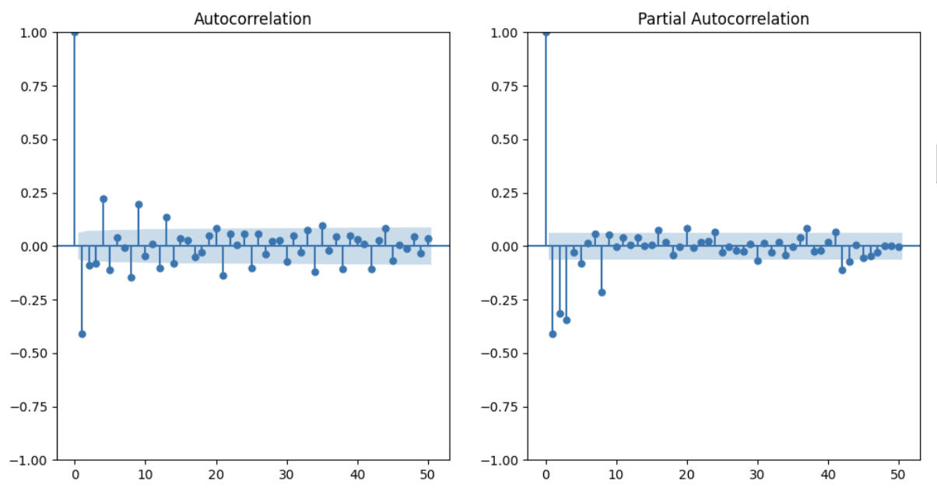
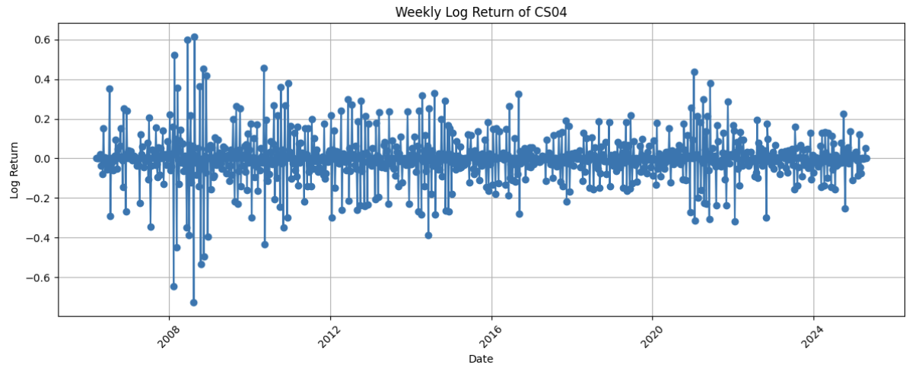
EDA - model choice
Residual correlation: Linear model residuals remain correlated with features like Extreme_Negative and Short_Ratio, suggesting missed nonlinear effects.
Volatility clustering: ACF/PACF plots reveal time-dependent structure in returns → GARCH is appropriate.
Heteroscedasticity: Breusch-Pagan test confirms non-constant error variance → ARIMA + GARCH preferred.

Slide 53
Model Compare
Rolling Forecast Framework:
Training window: 52 weeks( Linear & XGBoost ); 80 weeks(ARIMA)
Forecast horizon: 1 week ahead
Rolling step: 1 week (expanding or fixed window)
Target Variable: Weekly gold return = log(CS04_t+1) – log(CS04_t)
model | feature | OOS R^2 | OOS MSE
linear regression | all features | 0.1556 | 0.0271
linear regression | selected features | 0.0153 | 0.01506
XGBoost | all features | -0.5510 | 0.0227
XGBoost | selected features | -0.2985 | 0.0190
Arima(0,0,0) | all features | -0.4210 | 0.0412
Arima(0,0,0) | selected features | -0.0065 | 0.0149
Arima(1,0,0) | all features | -0.2683 | 0.0188
Arima(1,0,0) | selected features | 0.1448 | 0.0126
Arima(1,0,1) | all features | -0.3703 | 0.0202
Arima(1,0,1) | selected features | 0.2815 | 0.0106
Arima(1,1,1) | selected features | 0.1575 | 0.0093
Arima(1,0,0)+Garch | selected features | 0.1448 | 0.0126
ARIMA(1,0,1) is the best model in the current case, with the highest R^2 and second to lowest MSE

Slide 54
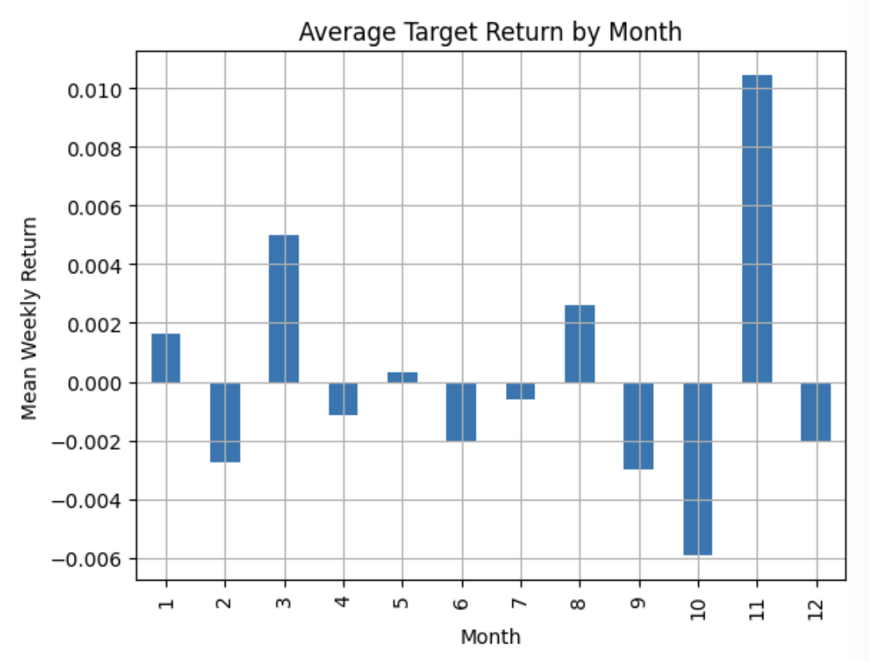
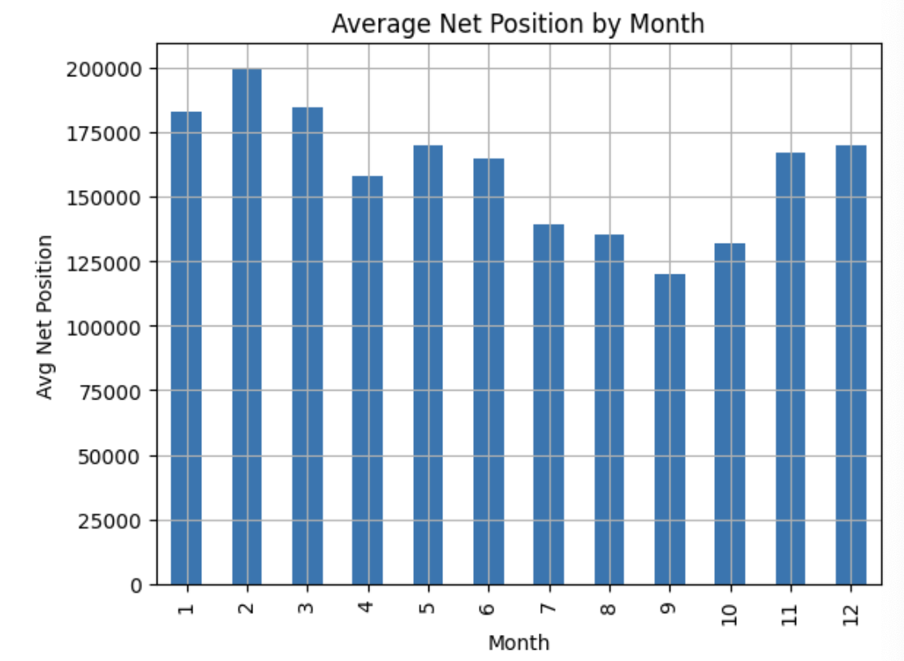
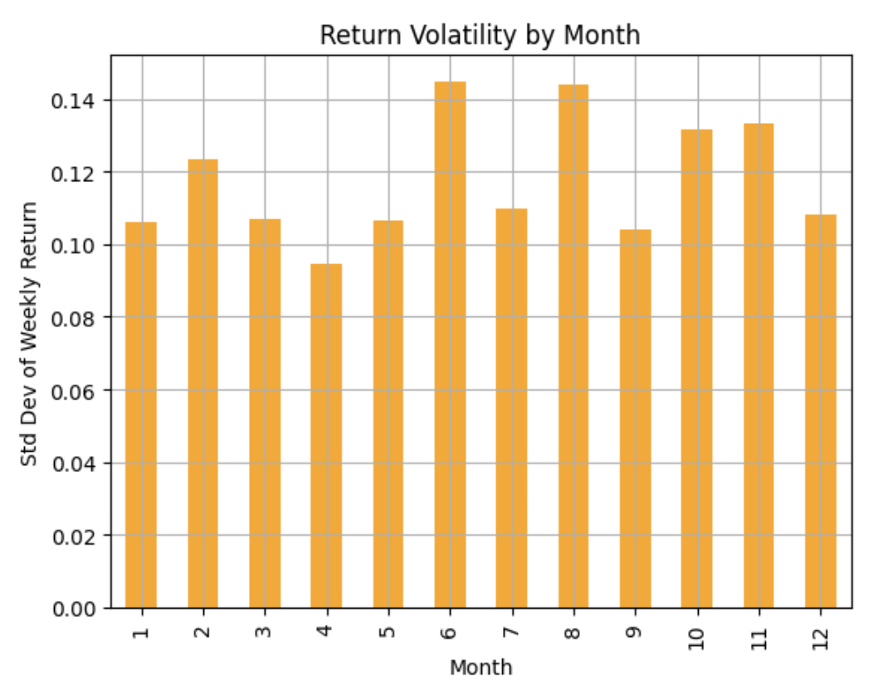
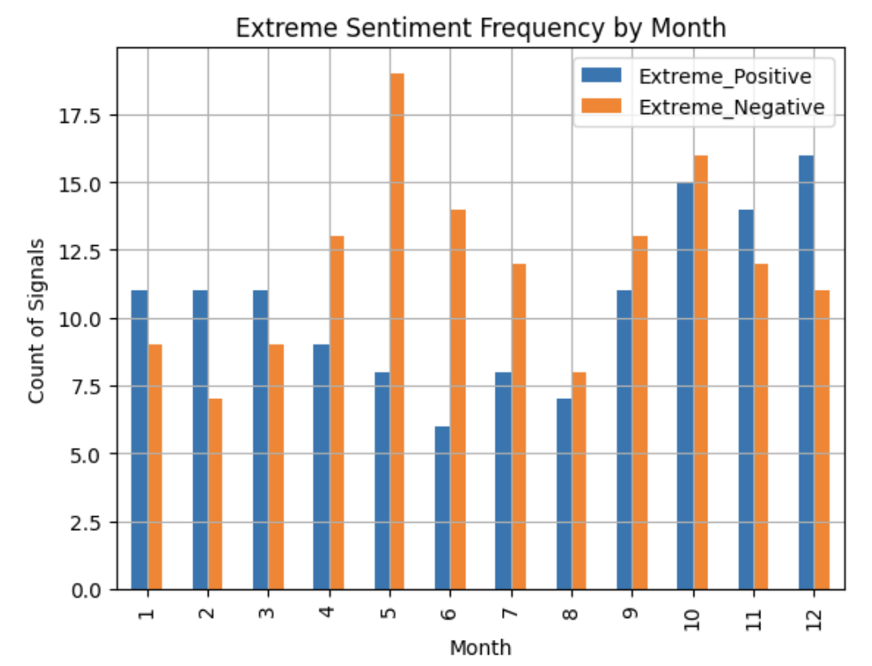
EDA – Corn Characteristics
Recognizing the seasonal dynamics in corn futures, we extract the month from reporting dates to analyze how returns, volatility, and positioning vary across the year. Studies (CME Group, 2023; CiteseerX, 2007) show that market behavior in agricultural commodities is heavily influenced by seasonal factors such as planting and harvest periods, justifying the focus on monthly patterns.
Notable positive seasonality in December; weaker or negative returns mid-year...
Average Net Position is highest during early-year months and declines notably around Aug-Sept, suggesting seasonal unwinding.
Standard deviation of weekly returns shows higher volatility during June–August, peaking in July.
“Extreme Positive” sentiment signals peaks around Oct-Dec while “Extreme Negative” sentiment peaks around May-July.

Slide 55
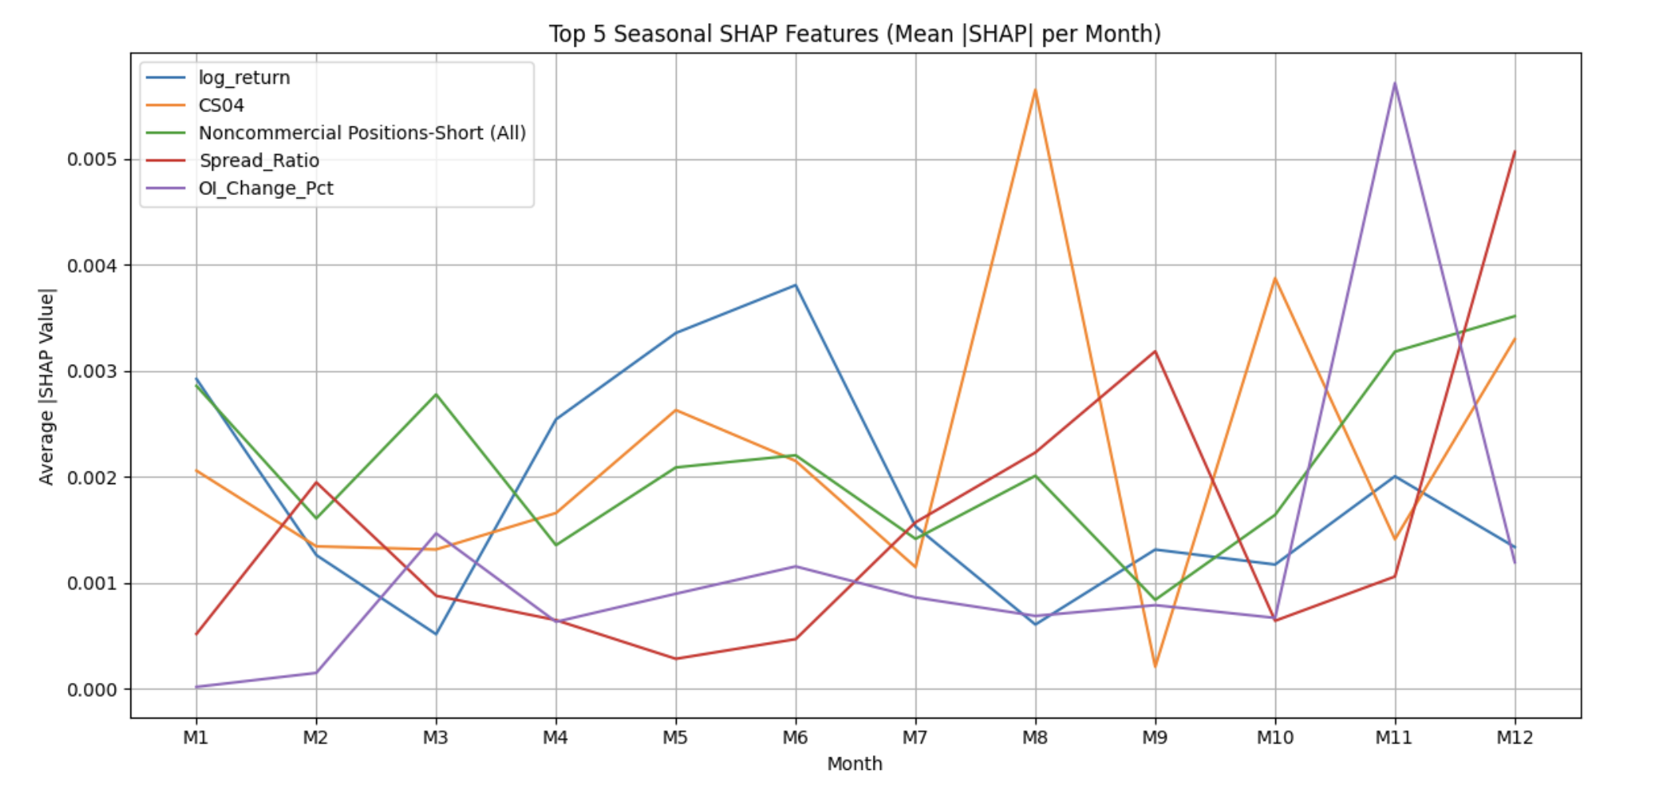
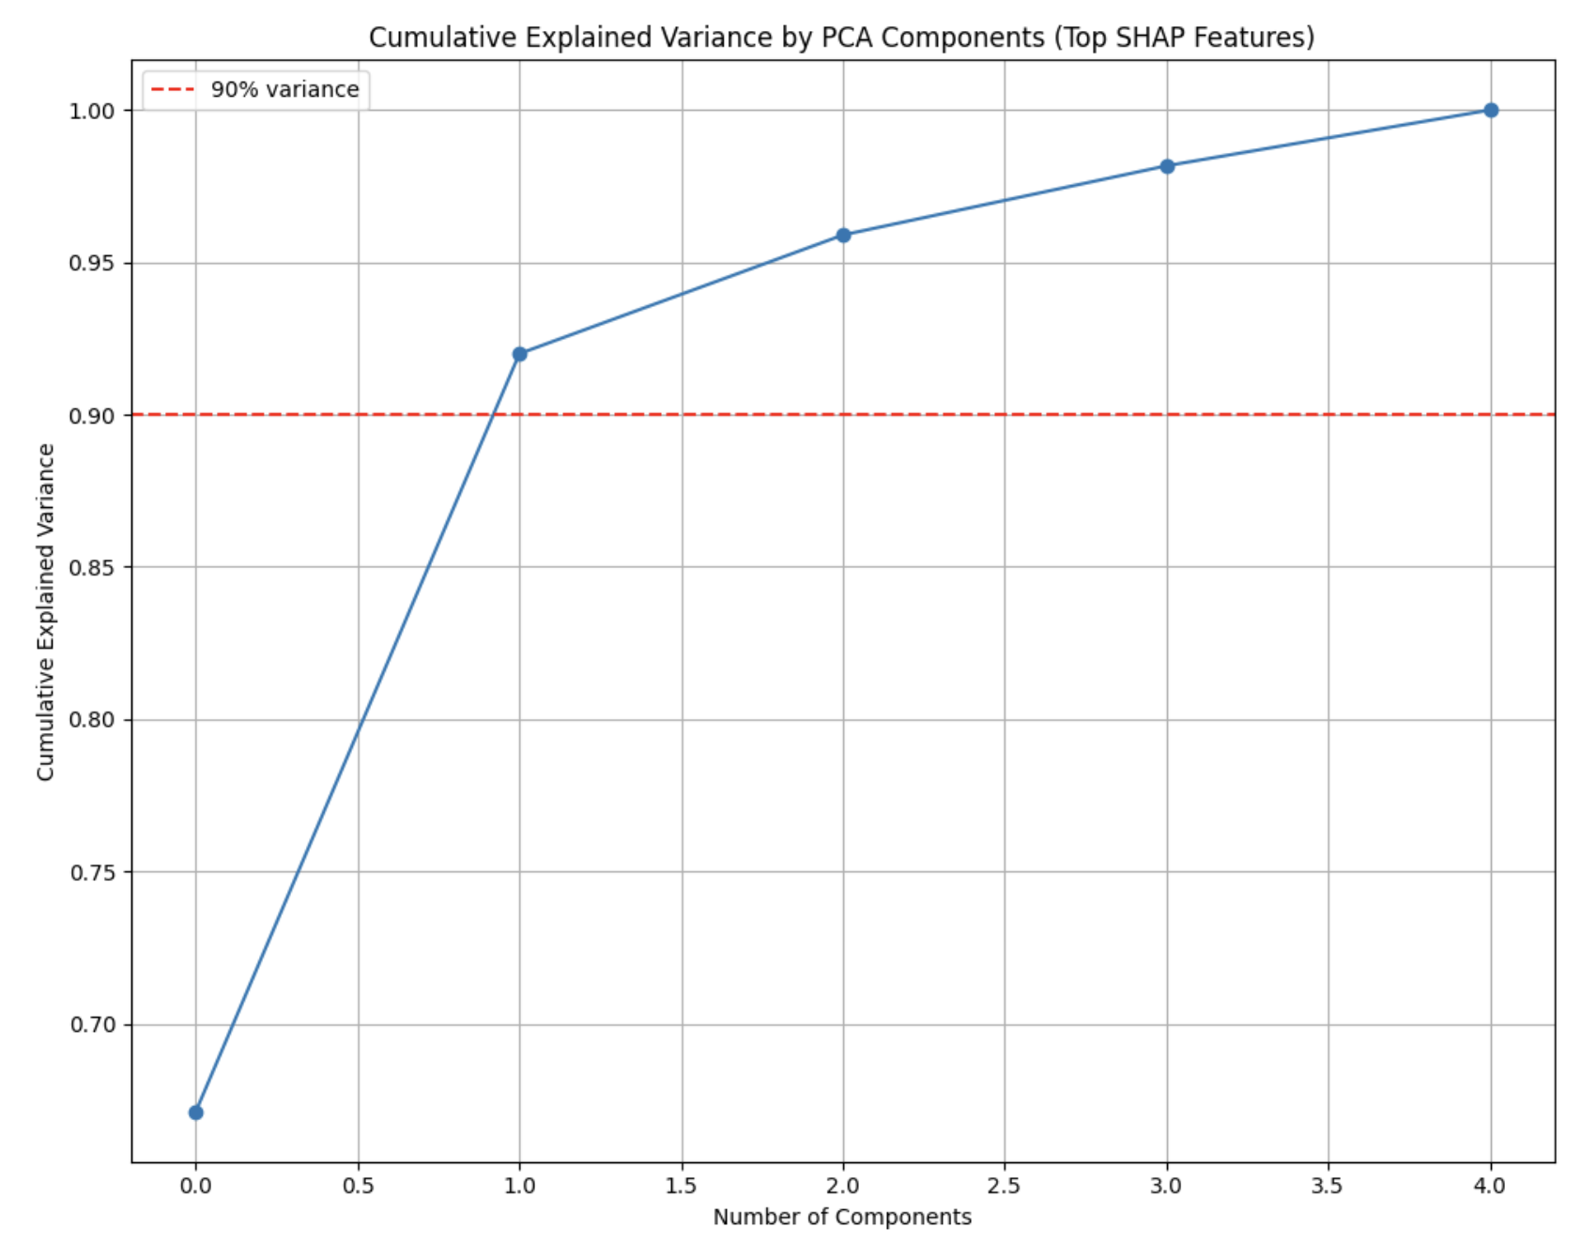
Feature Importance: Seasonal SHAP Analysis after XGBoost
Data Preparation:
1. Extract ‘Month’ to capture seasonal patterns
2. Drop redundant columns and create month dummy variables for modeling
Model Training:
1. Standardized inputs and trained XGBoost model
2. Computed SHAP values to asses feature importance over time
3. Identified Top 5 SHAP features(log_return, CS04, Noncommercial Position- Short (All), Spread_Ratio, OI_Change_Pct
The first feature (log_return) captured over 90%
variance, confirming seasonal drivers.

Slide 56
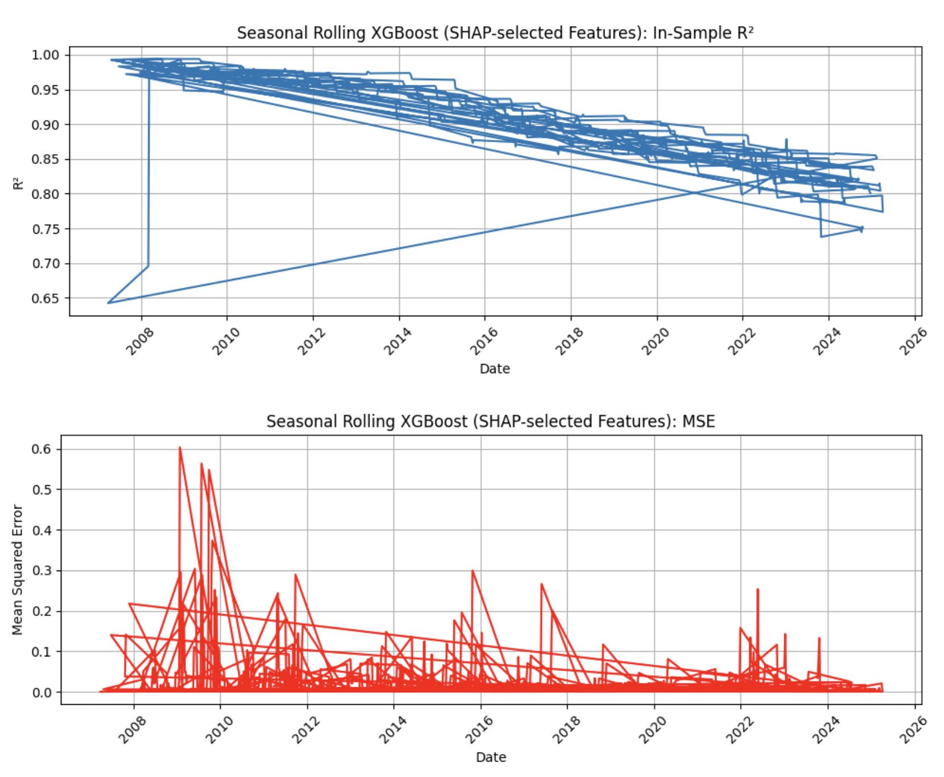
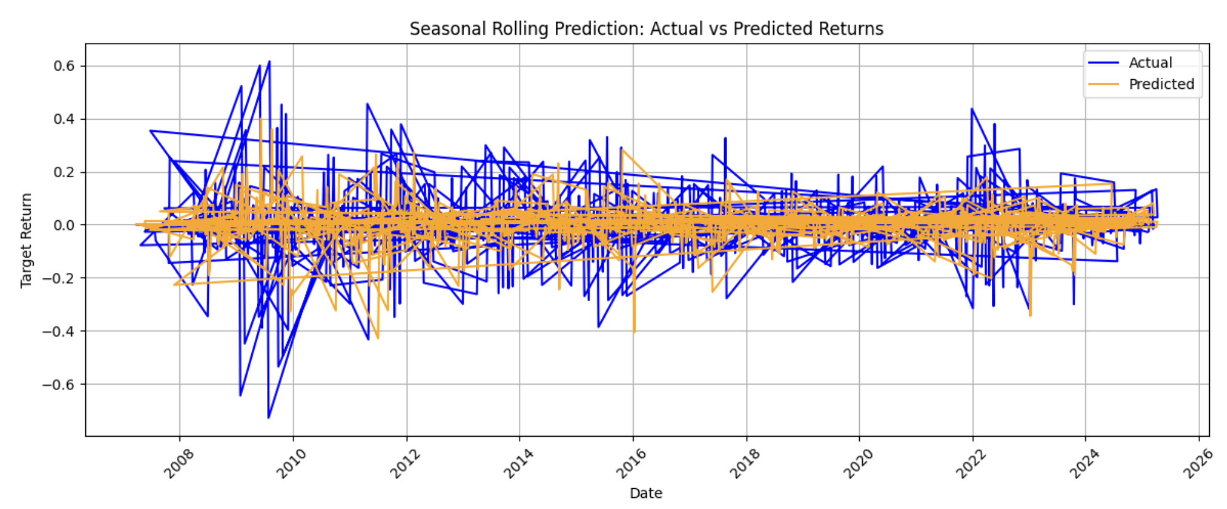
Model Performance and Insights
The model captures seasonal patterns well initially, but market drift, changing participant behavior, or evolving market structure erode model performance over time.
The model becomes more stable over time but cannot eliminate sudden forecast errors caused by rare or extreme market events.
Seasonal Rolling XGBoost Evaluation
Rolling expanding training by month.
Average In-sample R²: 0.9078
Average Rolling MSE: 0.0235
Out-of-Sample R²: -0.882
Out –of-Sample MSE: 0.0235
Key Observations
Strong in-sample fit; limited out-of-sample predictability due to market noise.
Actual returns exhibit large regime shifts not fully captured by the model.
Model captures general structure but struggles with extreme volatility periods.
The model is effective at stabilizing predictions and avoiding overfitting to noise but struggles to anticipate tail events. This behavior is consistent with a bias-variance trade-off in forecasting volatile financial series.

Slide 57
Feature Engineering
Recommendations and Rationale
Key Position Metrics
The Percent-Net-Long (PNL) method has proven effective in normalizing COT data. This approach:
Subtracts shorts from longs within a category
Divides by total contracts held by that category (shorts + longs)
Creates a normalized indicator that quantifies both magnitude and direction of each trader category's position
This normalization is particularly valuable as the number of contracts held by each trader group changes dramatically over time
Commercial vs. Non-Commercial Data
Research indicates that:
Commercial data generally contains more predictive power than non-commercial data for futures returns, particularly in soft commodities
Neither commercial nor non-commercial positions are individually predictive, but they show significant predictive power when analyzed together
Commercial shorts have demonstrated particularly high predictive value

Slide 58
Feature Engineering
Research and Recommendations
Ratio-Based Features:
Consider the relationship between commercial and non-commercial positions. Track how much commercial activity is being absorbed by non-commercial traders
Include Non-Reportable Positions:
Don't overlook this category in your analysis
Commercial Shorts Prediction:
Consider implementing a linear regression with a 30-point prediction window to forecast commercial shorts. Use the regression itself as a feature in your predictive model
This approach aligns with established research while avoiding redundant features and multicollinearity issues that were previously identified.

Slide 59
Final Insights and Recommendations
Asset Classes
COT Prediction Power
Generalized Model
Specialized Model
Feature Engineering
Contrarian Trading Signal
Next Steps

Slide 60
Appendix
The Behavior and Performance of Major Types of Futures Traders
Changyun Wang examines differences in trading behavior and performance between speculators and hedgers across 15 U.S. futures markets. Concludes that speculators act as contrarian traders responding to sentiment, while hedgers engage in trend-following strategies and tend to underperform.
Speculation and the Informational Efficiency of Commodity Futures Markets
Martin T. Bohl, Alexander Pütz, Christoph Sulewski. Studies how speculative trading activity impacts the informational efficiency of commodity futures prices. Finds that increased speculative activity is associated with lower market efficiency, driven mainly by traditional long-short speculators (with negligible influence from index traders).
Hedgers, Funds, and Small Speculators in the Energy Futures Markets
Dwight R. Sanders, Keith Boris, Mark Manfredo. Analyzes CFTC COT data for crude oil, gasoline, heating oil, and natural gas futures. Finds that noncommercial (speculative) traders increase net positions following price rises while commercial hedgers cut back, indicating that traders’ positions generally follow (rather than lead) market price movements.
What Does Futures Market Interest Tell Us About the Macroeconomy and Asset Prices
Harrison Hong, Motohiro Yogo. Argues that futures market open interest (the total contracts outstanding) provides information about future economic activity and asset returns beyond what futures prices alone reveal. Shows empirically that open interest is highly pro-cyclical and helps predict commodity returns, bond returns, and interest rates, even after controlling for other known predictors.

Slide 61
Appendix
Hedging Pressure Effects in Futures Markets
Frans A. de Roon, Theo E. Nijman, Chris Veld. Introduces a model where futures risk premia are driven by hedging pressure (hedgers’ net positions) both within the same market and across related markets. Empirical tests on 20 futures markets show that own-market and cross-market hedging pressures significantly affect futures returns (controlling for risk factors and price pressure) and even help explain returns of the underlying assets.
On the Predictive Role of Large Futures Trades for S&P500 Index Returns
Haojun Chen, Daniela Maher. Assesses if positions of large trader groups (commercial firms, hedge funds, etc.) in S&P 500 futures can predict subsequent stock index returns. Finds only weak and inconsistent predictive signals – e.g. a positive but unstable correlation for commercial traders and a short-lived informational edge for hedge funds – and concludes that the 3-day-delayed weekly COT data and mixed results make it an unreliable trading signal.
Investor Sentiment and Forecasting Ability: Evidence from COT Reports in Precious Metal Futures Markets
Yang Zhang, Jason Laws. Investigates whether an investor sentiment index derived from COT report data can forecast returns in gold, silver, and platinum futures. Finds that sentiment mostly moves with current prices (commercial traders are contrarian to price changes, while non-commercial/speculative traders are trend-followers) and generally does not lead future price movements, providing little support for sentiment as a predictive indicator.
Smart Money: The Forecasting Ability of CFTC Large Traders in Agricultural Futures Markets
Scott H. Irwin, Dwight R. Sanders, Robert Merrin. Investigates whether trader position data from the CFTC’s Commitment of Traders reports can predict agricultural futures returns. Finds virtually no forecasting edge – trader positions do not systematically lead price moves – but strong evidence that traders respond to price changes (with large speculators tending to be trend-followers), implying little value in COT data for predicting market movements.

Slide 62
Appendix
The Commitment of Traders Report as a Trading Signal?
Simon Dreesmann, Tim Alexander Herberger, Michel Charifzadeh. Develops a short-term reversal trading strategy using comprehensive COT report data across multiple futures markets. While a COT-based strategy outperforms a buy-and-hold benchmark in several individual markets, its advantage disappears at the portfolio level (no excess Sharpe or abnormal returns), suggesting that COT information is largely already reflected in efficient market prices.
Returns to Speculators and the Theory of Normal Backwardation
Eric C. Chang. Uses historical commodity futures data (wheat, corn, soybeans) to test Keynes’s normal backwardation theory (whether hedgers pay a risk premium to speculators). Finds that speculators did earn positive risk‐premium returns at the expense of hedgers, especially in later years, supporting the presence of a futures risk premium.
Commitment of Traders, Basis Behavior, and the Issue of Risk Premia in Futures Markets
Arjun Chatrath, Youguo Liang, Frank Song. Investigates how trader positions reported in the CFTC’s Commitment of Traders (COT) report relate to futures price behavior and risk premia. Examines the link between the composition of hedgers vs. speculators and the behavior of the futures basis to determine whether systematic risk premiums exist in these markets.
Inside the Oil Market: The Relationship Between Commercial Trading Activity and Subsequent Price Movements
Vijay Chandar. Investigates whether the trading activity of commercial hedgers in the crude oil futures market foreshadows future price movements. Provides evidence that surges in commercial short positions often precede oil price declines, suggesting that commercial traders’ positioning contains informational value that could be used to anticipate price trends.

Slide 63
Appendix
Machine Learning in Futures Markets
Fabian Waldow, Matthias Schnaubelt, Christopher Krauss, Thomas G. Fischer. Applies machine learning techniques to develop a quantitative trading strategy in futures markets. The authors preprocess continuous futures data and train ML models to predict which contracts will outperform, enabling a long/short portfolio that delivers significant out-of-sample profits (challenging semi-strong market efficiency).
Continuous Futures Data Series for Back Testing and Technical Analysis
Saulius Masteika, Aleksandras V. Rutkauskas, Andrea Janes. Discusses methods to construct continuous futures price series for robust backtesting and technical analysis. Presents techniques for rolling contracts (stitching expiring futures into one series) to avoid artificial price jumps, ensuring historical data consistency for evaluating trading strategies.
Relative Basis and the Expected Returns of Commodity Futures
Ming Gu, Wenjin Kang, Dong Lou, Ke Tang. Proposes a novel relative basis measure (the near-term futures basis minus a distant contract’s basis) to better isolate the commodity convenience yield. Shows that this relative basis is a powerful predictor of future commodity futures returns, outperforming the traditional basis measure, while it has no predictive power in financial futures (consistent with inventory-based theory of storage).
Who Wins and Who Loses?
Trader Returns and Risk Premiums in Agricultural Futures Markets** – Nicole M. Moran, Scott H. Irwin, Philip Garcia. Analyzes nearly a decade of data on large trader positions and profits in 12 agricultural futures markets to see which participants consistently gain or lose. Finds that commodity index traders (passive long-only investors) were the biggest losers—incurring multi-billion dollar losses in most markets—directly contradicting the normal backwardation theory that such speculators earn positive risk premiums.

Slide 64
Appendix
The Predictive Content of Commodity Futures
Menzie D. Chinn, Olivier Coibion. Examines whether commodity futures prices serve as unbiased and accurate forecasts of subsequent spot prices across energy, metal, and agricultural markets. Concludes that energy futures are generally unbiased predictors of future spot prices, whereas many other commodity futures exhibit bias; overall, futures’ predictive performance is on par with a random walk (though better than some econometric models) and has improved in more recent years.
Capturing the Risk Premium of Commodity Futures
Basu, D., & Miffre, J. (2013). "Capturing the Risk Premium of Commodity Futures." Journal of Banking & Finance.
Do Speculators Drive Crude Oil Futures Prices?
Büyüksahin, B., & Harris, J. H. (2011). "Do Speculators Drive Crude Oil Futures Prices?" Energy Economics.
The Role of Inventories and Speculative Trading in the Global Market for Crude Oil.
Kilian, L., & Murphy, D. (2014). "The Role of Inventories and Speculative Trading in the Global Market for Crude Oil." Journal of Applied Econometrics.
Commodity Hedging Pressure and Risk Premia.
Ready, R. (2018). "Commodity Hedging Pressure and Risk Premia." Journal of Financial and Quantitative Analysis.
Financialization and Structural Change in Commodity Futures Markets
Irwin, S. H., & Sanders, D. R. (2012). "Financialization and Structural Change in Commodity Futures Markets." Annals of the International Crude Oil Review.

Slide 65
Appendix
Strategic Petroleum Reserve Releases and Oil Market Dynamics.
Kilian, L., & Zhou, X. (2023). "Strategic Petroleum Reserve Releases and Oil Market Dynamics." Policy Working Paper.
Convective Risk Flows in Commodity Futures Markets
CFTC Office of the Chief Economist (2014). "Convective Risk Flows in Commodity Futures Markets."
EIA Policy Reports (2022–2024).
Seeley, Caleb (2009). Seasonal Volatility of Corn Futures Prices. Honors thesis, Duke University. Retrieved from https://hdl.handle.net/10161/1398.
Seeley, Caleb (2009). Seasonal Volatility of Corn Futures Prices. Honors thesis, Duke University. Retrieved from https://hdl.handle.net/10161/1398.
Robe, Michel A., and John Spencer Roberts. “Who Holds Positions in Agricultural Futures Markets.” SSRN Electronic Journal, 2019, https://doi.org/10.2139/ssrn.3438627. Accessed 27 Apr. 2025.
Shao, Hang, and Zhou Li. “The Predictive Effect of Heterogeneous Investor Behavior on Commodity Pricing.” Humanities and Social Sciences Communications, vol. 12, no. 1, 5 Apr. 2025, https://doi.org/10.1057/s41599-025-04795-y. Accessed 27 Apr. 2025.

Slide 66


THANKS!

